Slide 1
Unit 3
Chapter 5
Lessons 3 & 4
Pages 138-145

Slide 2
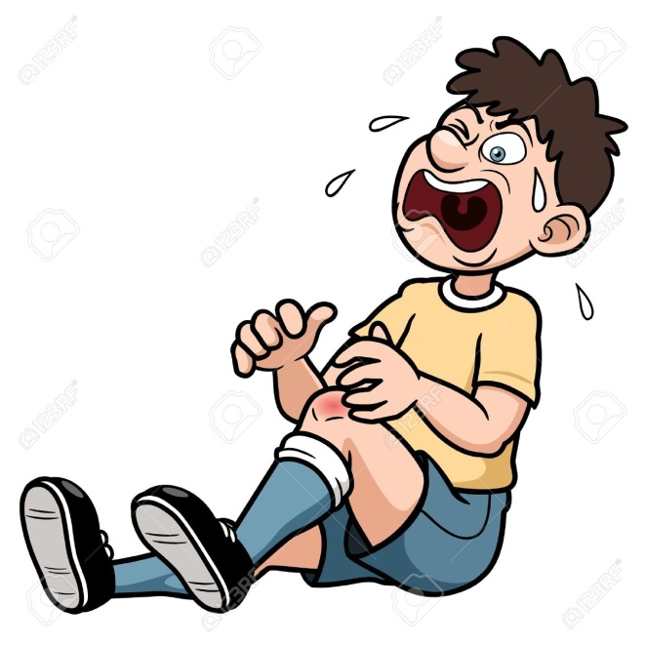
Please do now!
Have you or anyone you know had growing pains? Write three lines telling why you think people get growing pains.
Please share with your partner.

Slide 3
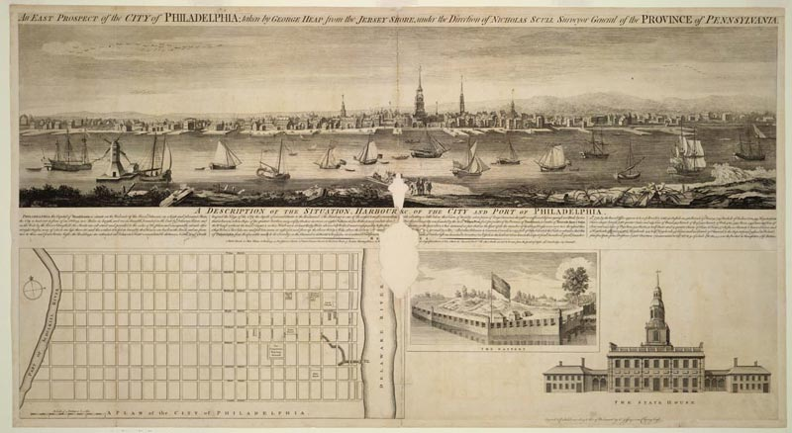
Philadelphia continued to grow. Many people who lived there were merchants or were involved in business.

Slide 4
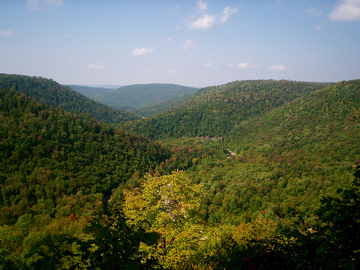
As Philadelphia and the surrounding area grew, many colonists moved to the frontier to get away from the big city.

Slide 5
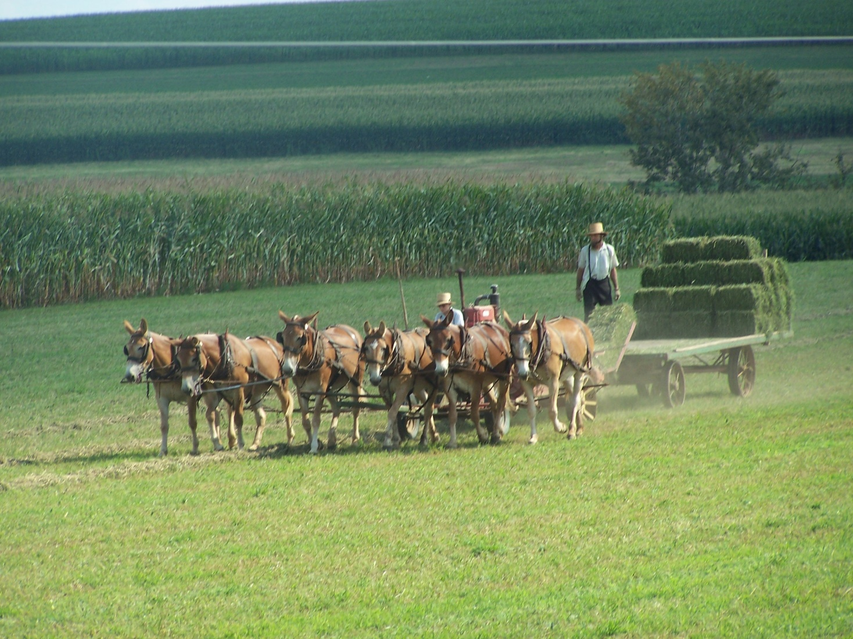
Most of the colonists who lived in rural Pennsylvania were farmers.

Slide 6
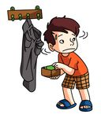
Please Do Now!
Has anyone ever stolen something from you? Write three lines describing what happened and how it made you feel.
Share your story with a partner.

Slide 7
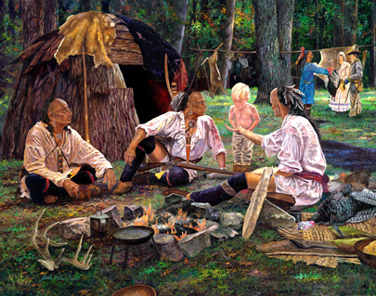
Some of these colonists purchased their land from the Native Americans, others took it without paying for it.

Slide 8
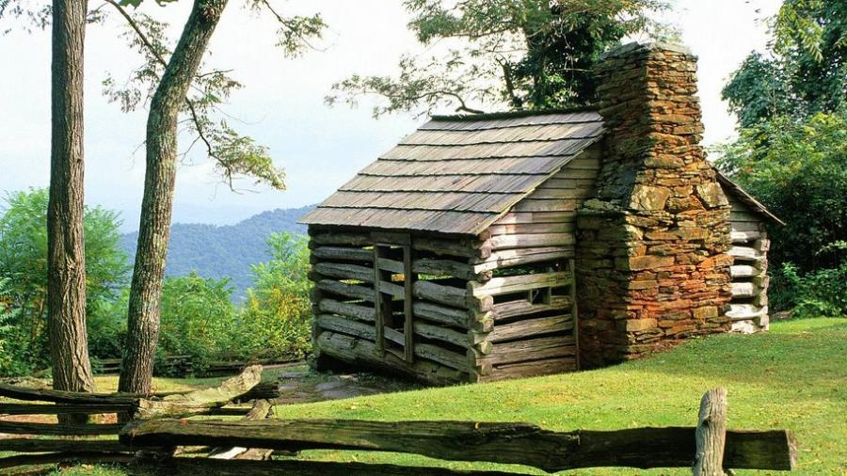
These people who started living on the land that belonged to the Native Americans are called squatters. (400,000 acres by 1740)

Slide 9
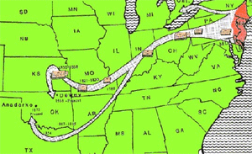
As the colonists continued to move out onto the frontier, the Native Americans were forced off their land.

Slide 10
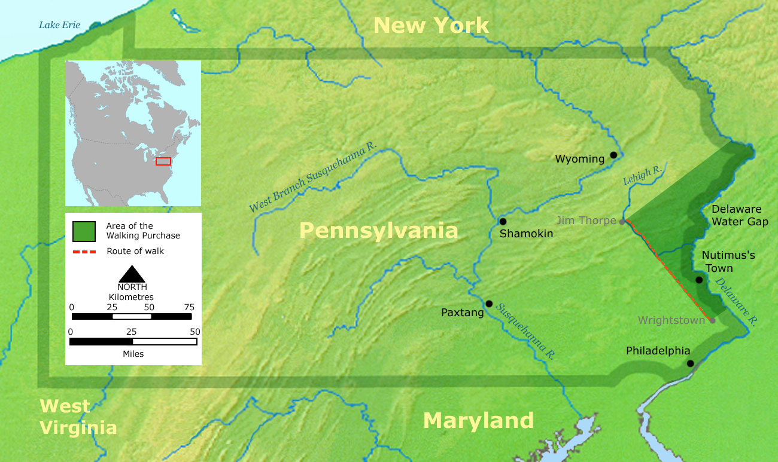
William Penn’s sons, John and Thomas, cheated the Lenape out of land through the Walking Purchase of 1737.

Slide 11
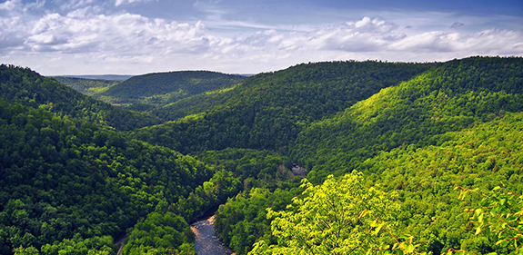
Many of the Lenape who were forced off their land from the Walking Purchase moved to the Susquehanna River Valley.

Slide 12
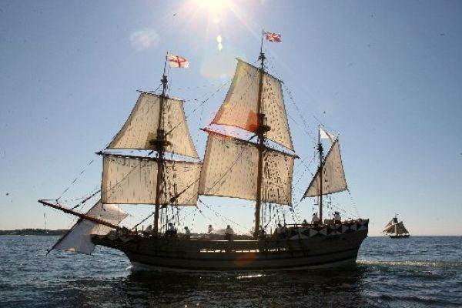
Colonists from many different European countries continued to come to Pennsylvania. They included: Scots-Irish, French, Dutch, Swedes, and Germans.

Slide 13
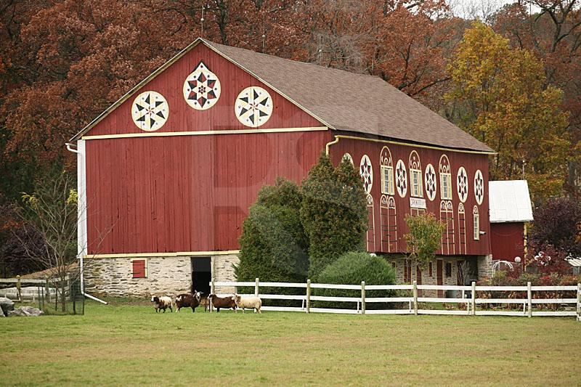
The customs of all these colonists made an impact on the culture of Pennsylvania.

Slide 14
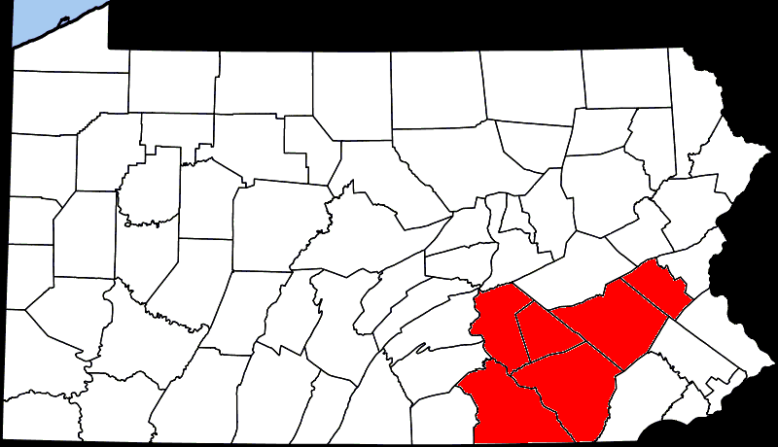
Pennsylvania Germans became known as the Pennsylvania Dutch and by the 1740s had settled in the Lehigh Valley, Susquehanna Valley, and Lancaster County.

Slide 15

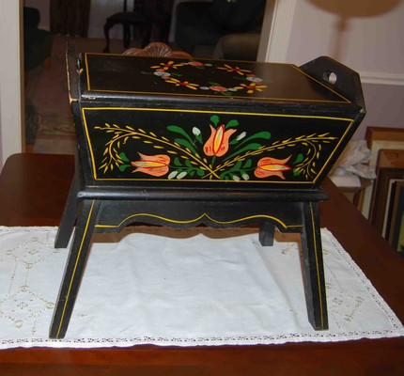
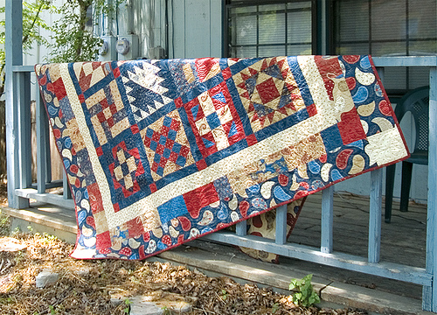
The Pennsylvania Dutch were known for the colorful designs they put on the crafts they made like furniture, dishes, and quilts.

Slide 16
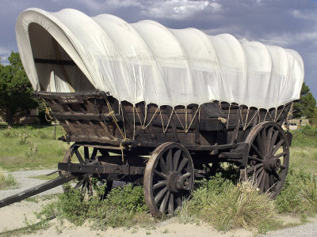
Other Germans living along Conestoga Creek built wagons that became known as Conestoga Wagons. These wagons could float across water.

Slide 17
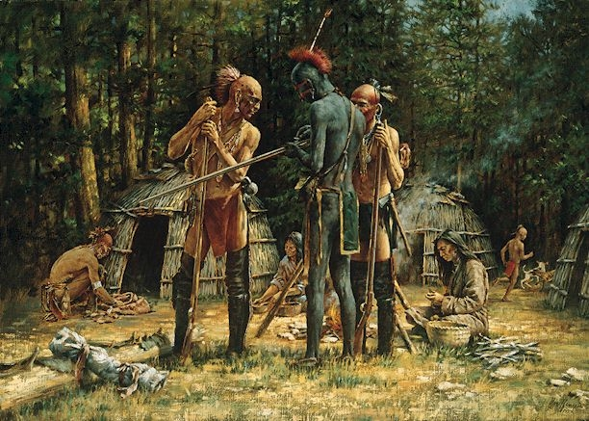
Exit Question
What happened to the Native Americans of eastern Pennsylvania and why did it happen?

